Slide 1
Community Detection Based on Social Interactions in a Social Network
Yen-Liang Chen, Ching-Hao Chuang, and Yu-Ting Chiu

Slide 2
Introduction
In recent years, many networks have become available for data mining.
A key task in mining is detecting the underlying communities, where a community is a group of people or objects sharing a common interest.
Finding and identifying subgroups in a social network is defined as a “community detection problem.”

Slide 3
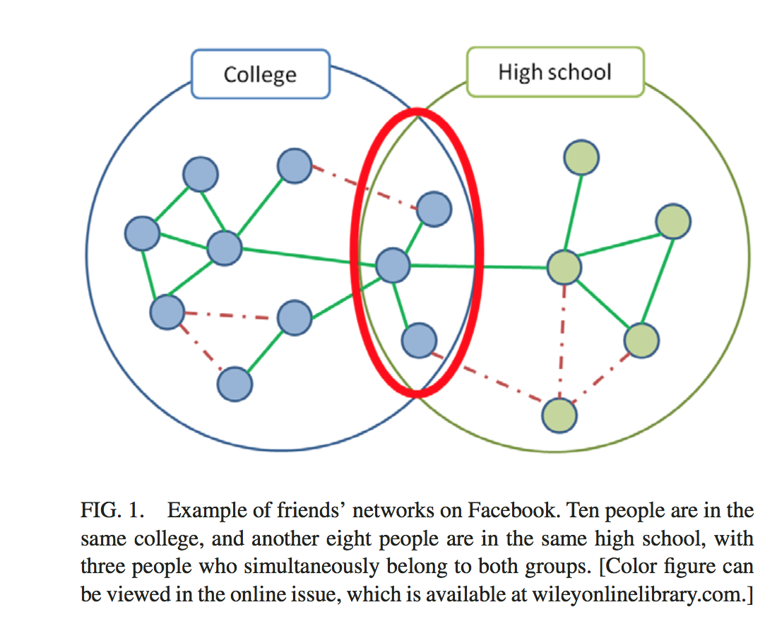
Background and Related Work
Spectral and Clustering Methods
Divisive Algorithms
Modularity-Based Methods
Model-Based Methods
Local Community Detection Methods
Feature based assisted methods
Although previous approaches have successfully been applied to community detection, they work based on the assumption that structural information is fully known. Additionally, past works have paid little attention to the issue of identifying multi-relational links.

Slide 4
A Social Interaction Approach
This research:
solves the problem of missing link
considers multiple relationships among users
applies the feature-based assisted method to find hidden communities
designs a method based on agglomerative clustering methods
conducts local community detection for a target user

Slide 5
Method: Problem Definition
Assume that a target user has N friends on Facebook belonging to K different communities.
U = {u₁, u₂ , … , u_{n}} set of friends of target Facebook user
P = {p₁, p₂, … . .. , p_{m}} set of post IDs of the target user
We want to detect K communities: {C₁, C₂, … C_{k}} among target’s friends
The more similar to user’s K predefined communities, the more accurate total prediction rate of communication detection is.

Slide 6
Method: Problem Definition
Target user’s friends can reply to a post to form a conversation. These conversations are defined as interaction.
Interaction sequence R_{i} is the list of users replying to a post p_{i}
An interaction transaction TR_{i} = {u_{j} | u_{j} appears in R_{i}} is derived by including every distinct user in R_{i}

Slide 7
Method: Problem Definition
From the interaction transactions, we find frequent itemsets as our initial groups. The set of all frequent k-itemsets can be denoted as:
LS is the set of all frequent k-itemsets
x is a k-itemset, where an itemset of length k is denoted as a k-itemset
sup(x) support value of itemset x, where the support of itemset x is the number of interaction transactions containing itemset x
min_sup is the specified minimum support level

Slide 8
Method: Problem Definition
A frequent itemset is defined as maximal if it has no frequent superset.
Ex. Suppose we have five items: a, b, c, d, e and {a,b,c} is a frequent itemset. If {a,b,c,d}, {a,b,c,e} and {a,b,c,d,e} are not frequent itemsets, then {a,b,c} is a maximal frequent itemset.
Therefore, we can define a set of maximal itemsets as ML = {ml₁, ml₂, ml₃...}, where mli is the i-th maximal itemset.
From here, we repeatedly merge smaller groups to form larger groups until the number of groups reaches K (number of communities). For this, we must have the following definitions to describe the merging process.

Slide 9
Definition 1: Overlapping of two itemsets
Let X and Y be two user sets in the ML set.
(X\Y) - users that are in X but not in Y
(Y\X) - represents the users that are in Y but not in X
(X*Y) - set of all pairs of users whose first member comes from X and second member from Y
To merge smaller groups to form larger groups, four indices are used to evaluate which itemset pairs should be merged.

Slide 10
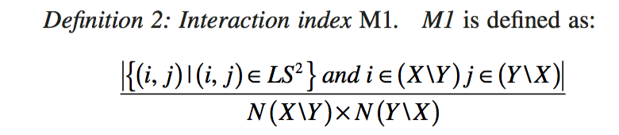
Definition 2: Interaction index M1.
Inspired from networking phenomenon: If two groups of people often participate in the same posts, they may belong to the same group. From this we have the first index M1, which is the proportion of pair of-users in (X/Y)*(Y/X) belonging to LS²
.
N(X\Y) - num. users in (X\Y)
N(Y\X) - num. users in (Y\X)
N(X\Y) x N(Y\X) - num. pairs of users in (X\Y)*(Y\X)
When M1 is large, it means that the users in (X\Y) and the users in (Y\X) frequently interact with each other in the same posts. Because they interact frequently, we consider merging them into the same group.

Slide 11
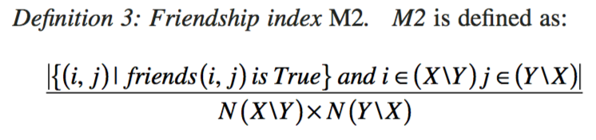
Definition 3: Friendship index M2.
If many pairs of people between two groups are friends with each other, these two groups may belong to the same group.
N(X\Y) x N(Y\X) - num. pairs of users in (X\Y)*(Y\X)
friends(i,j) - function that returns true if ui and uj are friends.
When M2 is large, it means that many users in (X\Y) and many users in (Y\X) are friends with each other. So, we consider merging them into a single group.

Slide 12
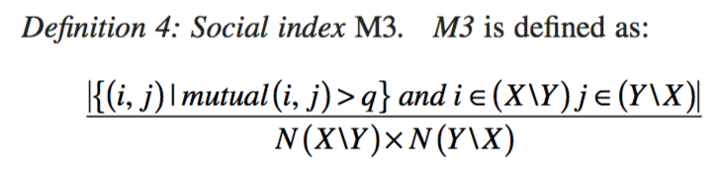
Definition 4: Social index M3.
If many pairs of people between two groups have many mutual friends, these two groups may belong to the same group. So, we have the index M3, the proportion of pair-of-users in (X\Y)*(Y\X) with more than q mutual friends
.
N(X\Y) x N(Y\X) - num. pairs of users in (X\Y)*(Y\X).
mutual(i,j) - the number of mutual friends users ui and uj have.
When the value of M3 is large, it means the users in (X\Y) and the users in (Y\X) have many common friends. We consider merging them into a single group.

Slide 13
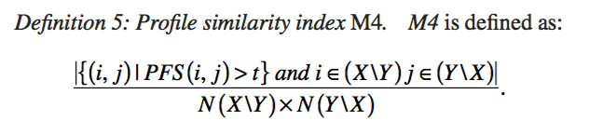
Definition 5: Profile similarity index M4.
The last index computes similarities in users’ profiles.
N(X\Y) x N(Y\X) - num. pairs of users in (X\Y)*(Y\X).
PFS - whole profile field similarity
When the value of M4 is large, it means the users in (X\Y) and the users in (Y\X) have similar profiles. So, we consider merging them into a single group.

Slide 14
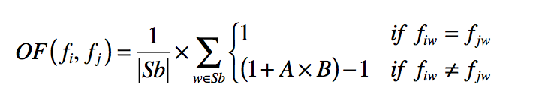
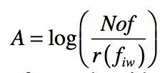

Definition 5: Whole Profile Field Similarity

Slide 15
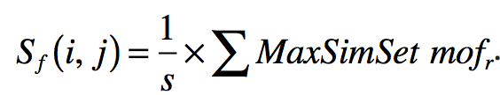

Definition 5: Whole Profile Field Similarity
V(fi) and V(fj) set of values for field f in the profiles of users ui and uv.
V(fi) = {fvi1, fvi2, . . . , fvis}, and V(fj) = {fvj1, fvj2, . . . , fvjt}. The lengths of V(fi) and V(fj) are |s| and |t|, respectively.
AllSimSet is the set of all single value field similarities between all possible pairs in V(fi) and V(fj)
AllSimSet = {of | of = OF(fvis, fvjt), ∀fvis ∈ V(fi), ∀fvjt ∈ V(fj)} and its length is |s|*|t|.
MaxSimSet is the set of s elements with the largest OF values selected from the AllSimSet
MaxSimSet = {mof1, mof2,..., mofs | mofr = maxfvjt∈V(fj)OF(fvir, fvjt )r =1 to s}
Field Similarity:
Profile Field Similarity:

Slide 16
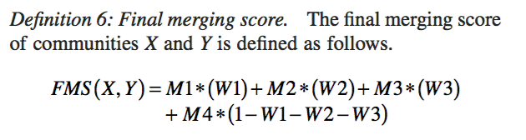
Definition 6: Final merging score.
To compute an overall score for a merging decision, the four merging indices are combined into a single index: final merging score (FMS).
Weights W1, W2, and W3 are user specified and must satisfy the relations 0 ≤ W1, W2, W3 ≤ 1, and (W1 + W2 + W3) ≤ 1.

Slide 17
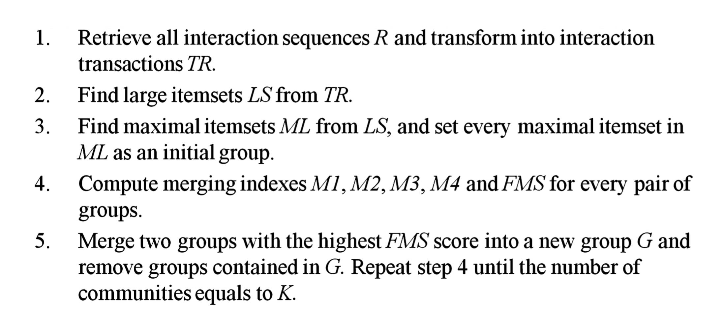
Algorithm

Slide 18
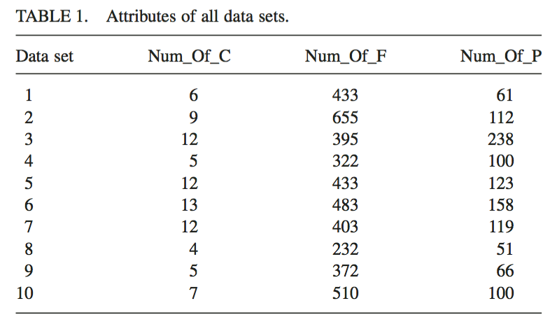
Experiment
10 target users who shared more than 50 posts on Facebook were used as 10 data sets for the experiment
Each target user was asked to analyze the friends who participated in the posts and classify them into different communities

Slide 19



Experiment: Total Community Purity
Community purity measures the extent to which a detected community contains objects from a predefined cluster.
Probability that detected community i belongs to predefined cluster j:
Community purity of a detected community.

Slide 20



Experiment: Total Cluster Purity
Cluster purity measures the extent of which a user-defined cluster contains object from a detected community.
Probability that that a member of user-defined cluster j belongs to detected community i:
Cluster purity of a user defined cluster:

Slide 21
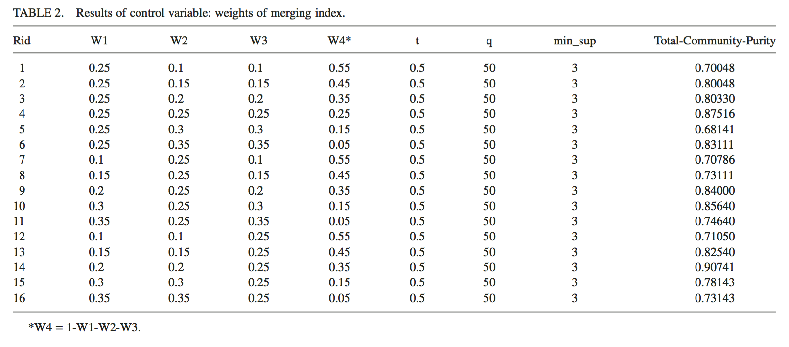

Slide 22
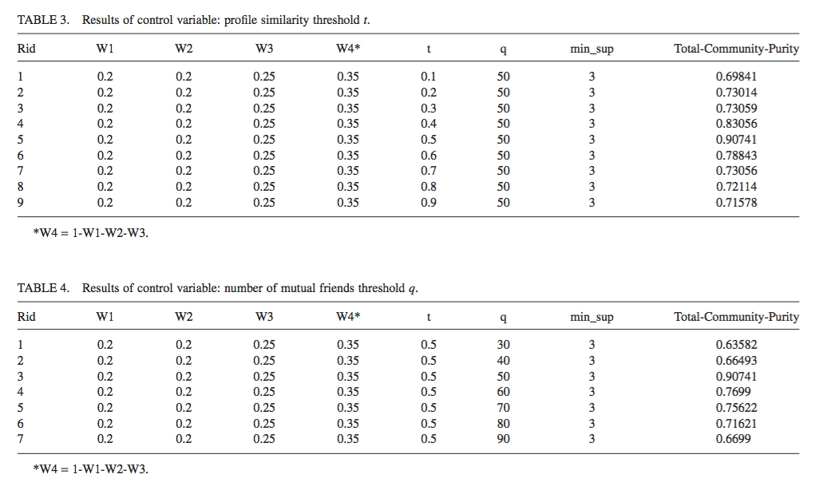

Slide 23
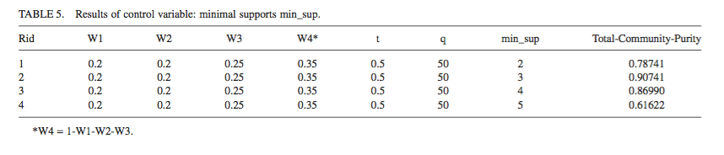
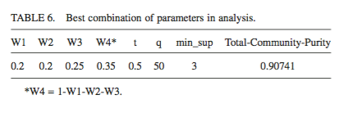

Slide 24
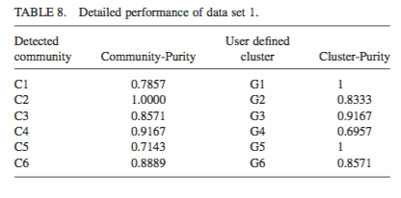
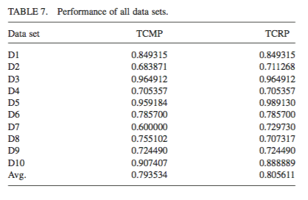
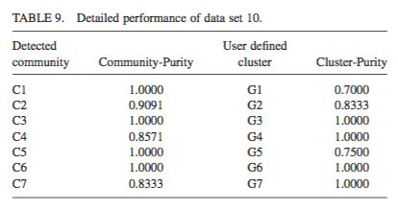

Slide 25
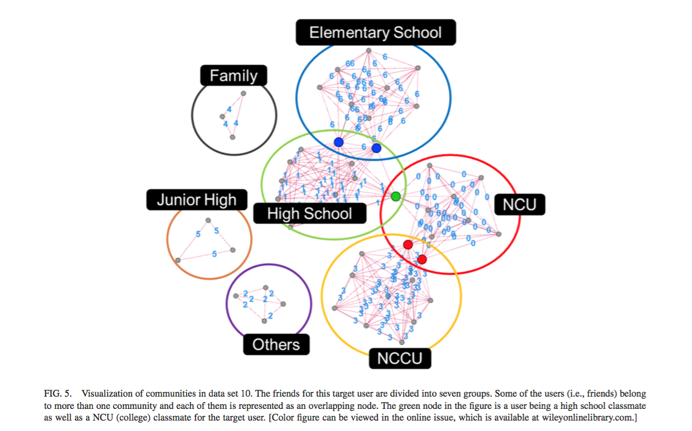

Slide 26
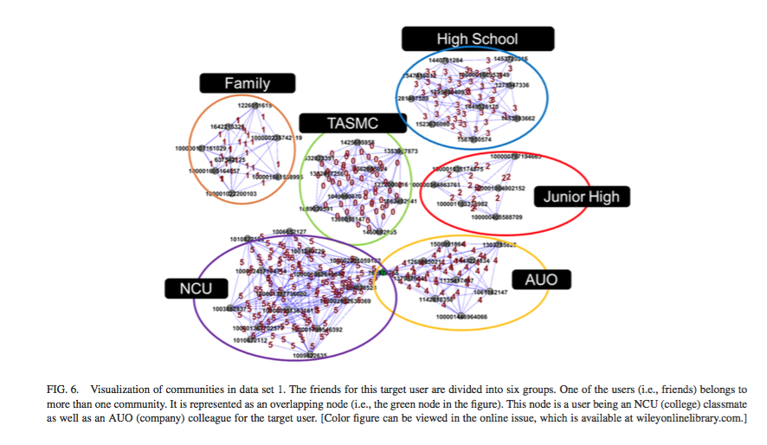

Slide 27
Conclusion
Average scores of TCMP and TCRP were both approximately 0.8.
Results were actually worse compared to a study from 2005, which had an accuracy score of over 0.9. However, this study did not use a social interaction approach.

Slide 28
Further Research
Addressing inaccurate or missing field values in profile similarity.
Detecting inactive/idle users
Design an optimization method to detect the right number of communities (K) without user intervention
Develop an interaction based method to develop communities in a dynamic network.

